Slide 1
Bringing flexibility provided by multi-energy carrier integration to a new MAGNITUDE
Régine Belhomme (regine.belhomme@edf.fr), EDF R&D
Nicole Pini (pini@eifer.org), EIFER

Slide 2
In today’s talk
About MAGNITUDE
Provision of flexibility to electricity system
The 7 project case studies
Technological opportunities and barriers
2 examples: ACS and Paris Saclay
The market perspective
Notes:
Régine

Slide 3
MAGNITUDE: context and target
Expected evolutions of the electricity system
EU 2020 and 2030 targets for the reduction of greenhouse gas emission
Increasing share of variable renewable energy sources
Expected increase of electricity demand (new usages e.g. electric vehicles, electrification of usages)
New or increased system risks: quality and security of supply, congestion, system stability, curtailments, difficulty to cover electricity demand at some periods of time, etc.
Needs for more flexibility, more active involvement of all the stakeholders and collaboration… at all levels (from distribution to pan-European)
Need to harness the service provision capabilities of both centralized and decentralized resources in a coordinated way (including both consumers and producers).
MAGNITUDE: develop business and market mechanisms, and coordination tools to provide flexibility to the European electricity system, by increasing and optimizing synergies between electricity, gas and heating/cooling systems.
Notes:
Régine

Slide 4
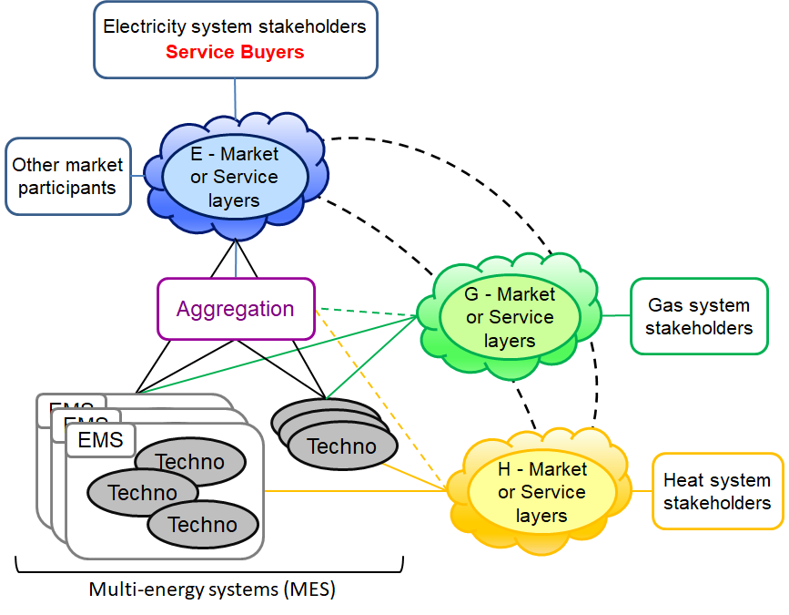
MAGNITUDE: approach
Flexibility services to be provided by
Multi-Energy Systems (MES) to the
electricity system
Flexibility provision capabilities of
identified cross-sector technologies
and MESs
Simulated and optimized control
strategies of technologies and systems
to maximize flexibility provision.
Benefits of pooling flexibilities of
portfolios of MESs through an
aggregation platform.
Innovative market designs for synergies maximization, implemented and assessed on a market simulation platform
Integrated system (MES, aggregation, market) and associated business models
Policy strategy and recommendations in a pan-European perspective
Notes:
Régine

Slide 5
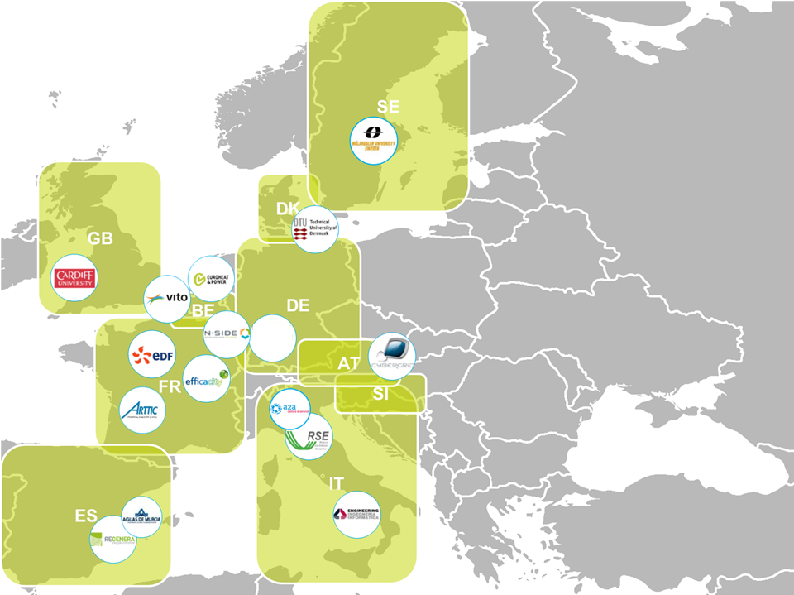

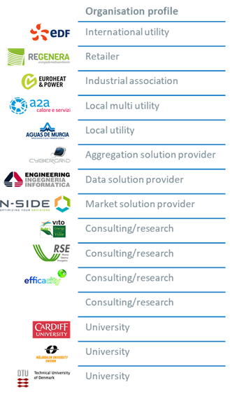


Consortium: 16 partners from 9 countries
Notes:
Régine

Slide 6
Flexibility provision to the electricity system
Key needs | Services selected
System adequacy & incentive signals for investors | Capacity requirement mechanisms (ensure enough capacity to meet the demand, e.g. winter peak) Capacity markets (e.g. FR, GB, IT soon) Strategic reserves (e.g. SE)
Reducing price risks & optimizing energy portfolios | Energy trades Day-ahead energy market (spot market) Intraday energy market
Balancing and frequency control | Provision of reserves for TSOs Frequency Containment Reserve (FCR) Automatic Frequency Restoration Reserve (aFRR) Balancing, manual Frequency Restoration Reserve (mFRR) and Replacement Reserve (RR)
Congestion management | Re-dispatching mechanisms or active power control at both transmission and distribution levels

Slide 7
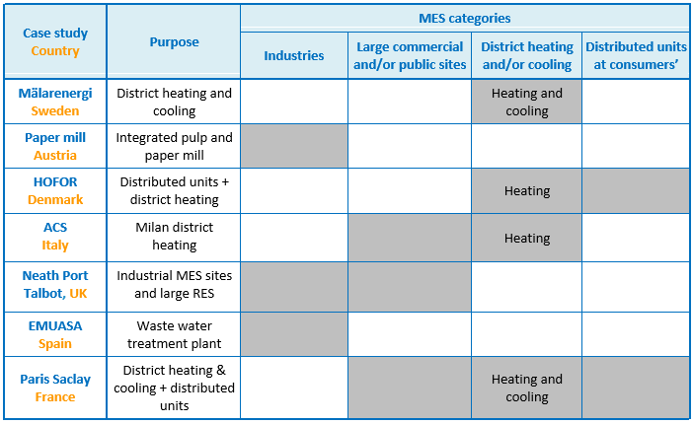
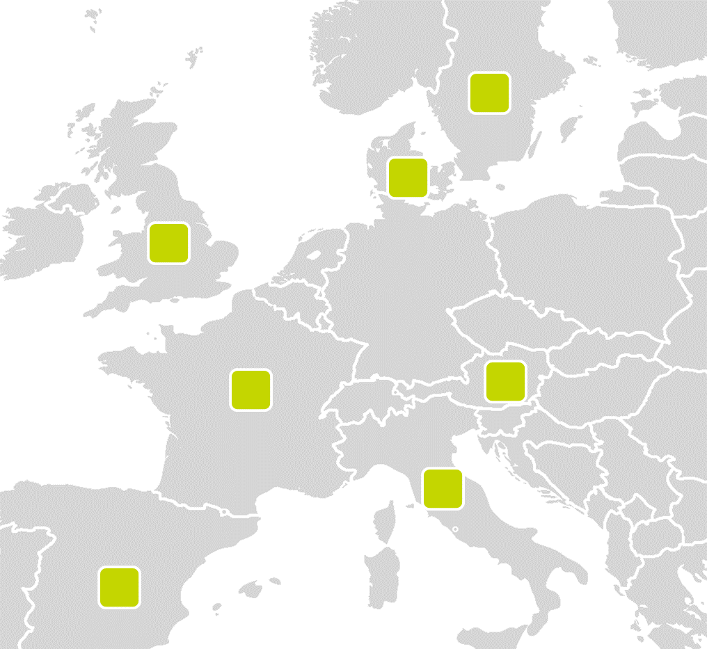
The 7 project case studies
Notes:
Nicole

Slide 8
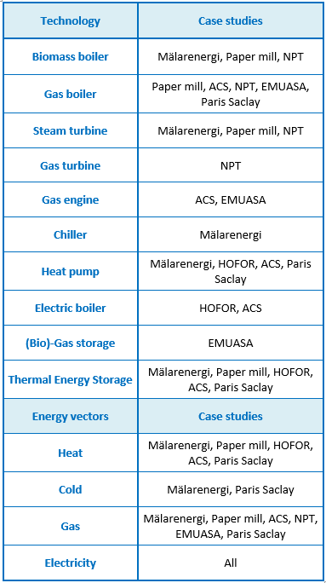
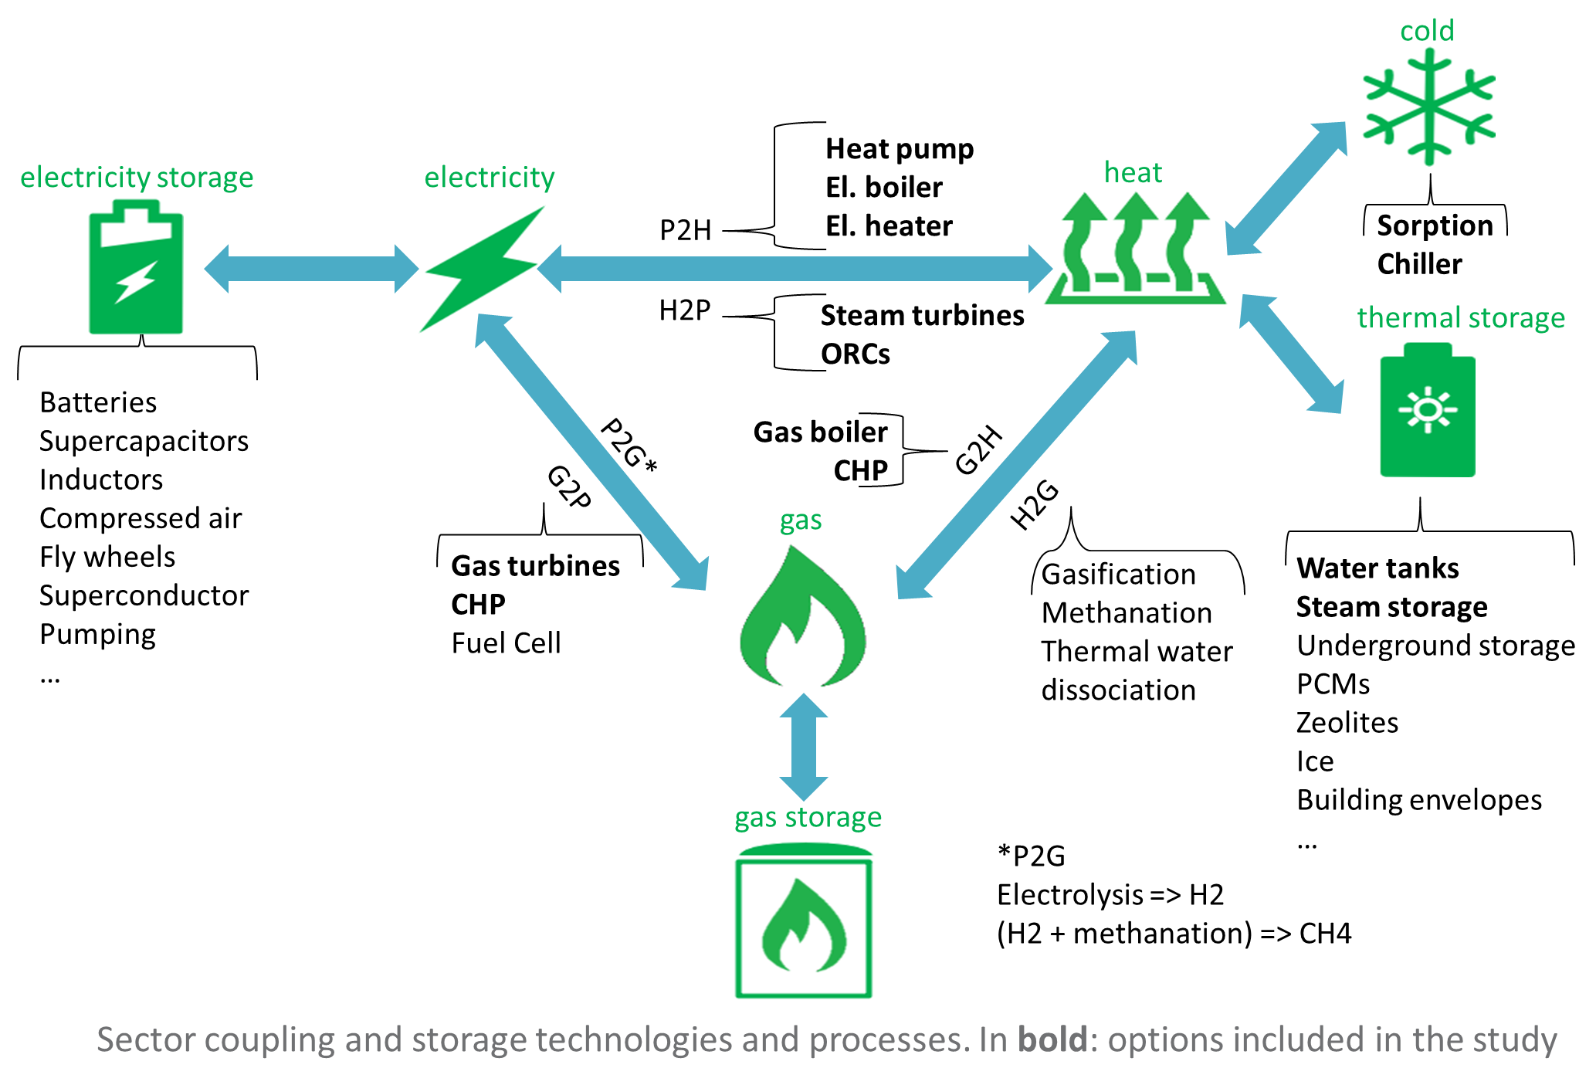
The 7 project case studies
Notes:
Nicole

Slide 9
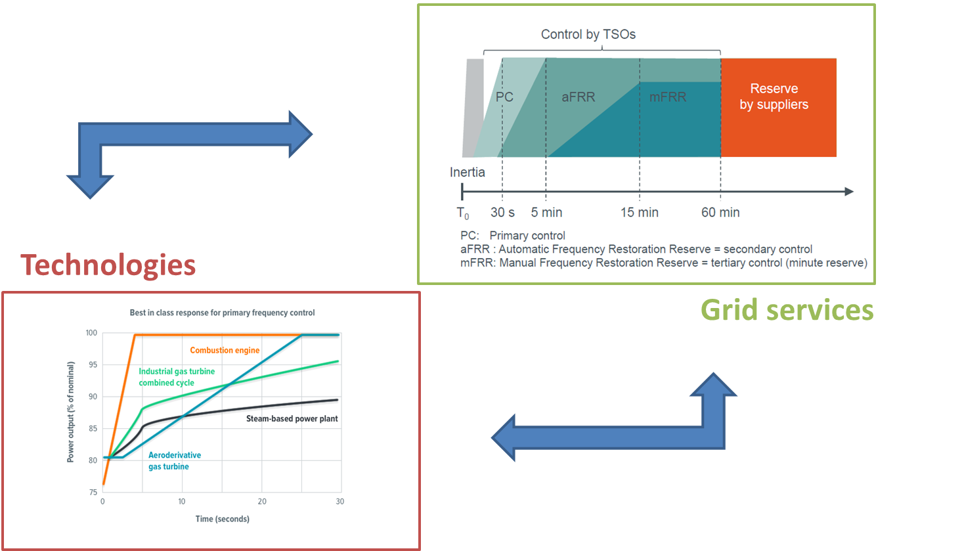
Technological opportunities and barriers
How can sector-coupling technologies and MES provide flexibility to the electricity system?
From a technical perspective, 3 ways of action:
  replacing a technology or adding a new one → (which often derives in an adaptation of the control strategy)
  changing the control strategy of one or several energy assets
  combining the two previous options
Notes:
Nicole

Slide 10
Technological opportunities and barriers
Opportunities
Power-to-Heat units: fuel shift between gas and electricity for heat and cold production extra revenues from flexibility services and aggregation (demand side management, local self-consumption, heat load shifting) → control and communication interfaces
Heat storage: to increase electricity production (CHP) or consumption (heat pumps/electric boilers) use of DHN as storage, to optimize heat production and apply innovative heat pricing schemes
Steam storage in industries: to shift from gas consumption to electricity (self-) consumption
Gas-fired generators: participation in flexibility markets (e.g. redispatch), using storage capacity of high pressure gas networks
Barriers and potential adaptations
Critical demand (industrial processes, DH) constraints Need of storage, forecast algorithms (also to avoid rebound effect), demand-side management
Technical limitations of the equipment (Ramping capability, lockout contraints, mechanical stress, minimum loads) Installation of storage and auxiliary peak units, improved scheduling and control
High maintenance costs due to fast and frequent load changes Improved optimization and control, development of innovative business models
Interconnection with external networks Analysis and upgrading of the bottleneck interconnection
Interoperability and data availability Improved monitoring systems, standardization and policy development
Notes:
Nicole

Slide 11
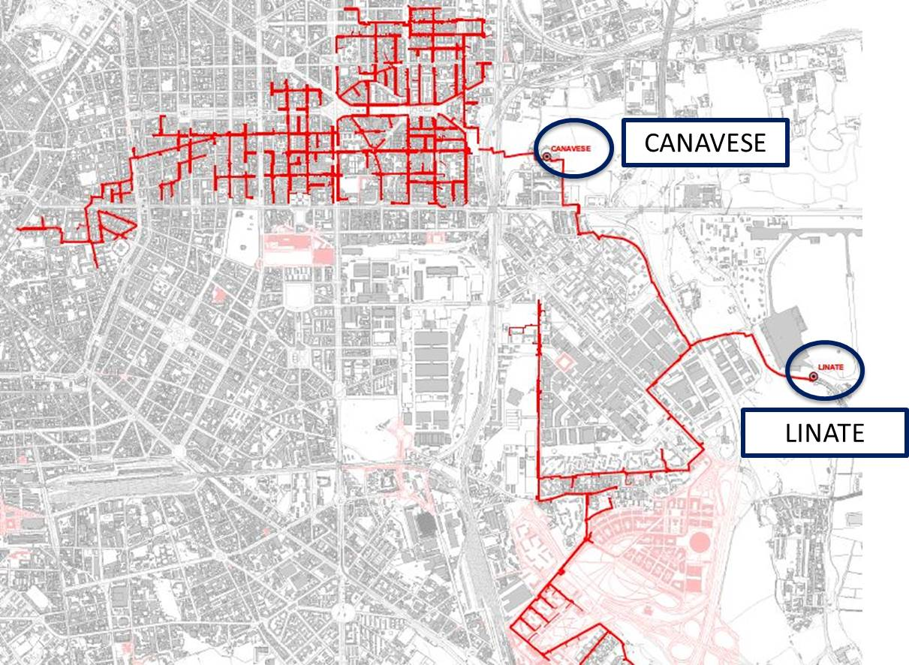
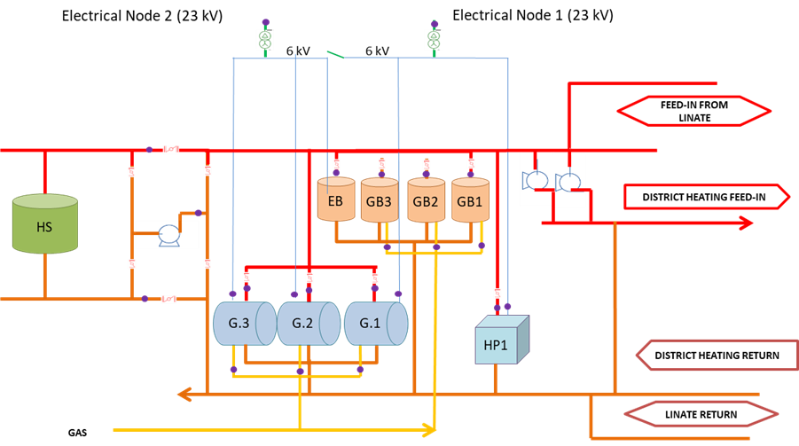
2 examples: ACS (Milan)
Key information
Type of system | 3rd generation district heating network (heat driven energy production)
Installed technologies | 3 CHP gas engines: 5.04 MWe, 4.4 MWt 2 Heat pumps: 15 + 3 MWt Electric boiler: 10 MWt 3 Gas boilers: 15 MWt 2 Heat storage tanks: 11 MWt (35 MWh)
Studied improvement strategies | Improvement of electrical network for FCR Improvement of heat storage capacity New heat pricing models for day/night tariffs as heat demand response
Flexibility provision | Participation to Day Ahead and Intra-Day markets Simulated: FCR, aFRR, mFRR
Source: ACS
Notes:
Nicole

Slide 12
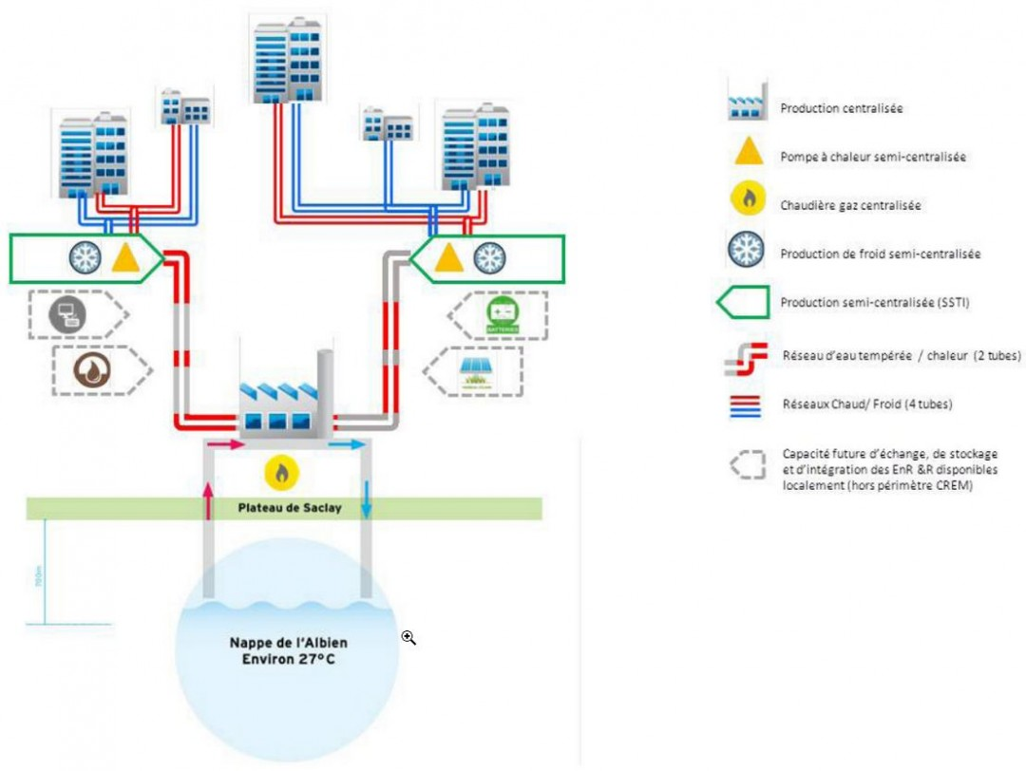
2 examples: Paris Saclay
Key information
Type of system | 4th generation district heating and cooling network
Installed technologies | Reversible heat pumps Gas boilers Geothermal wells feeding the low temperature loop (30-15 °C) + secondary distribution loops Total installed capacity: 37 MW heating (40 GWh/year), 10 MW cooling (10 GWh/year), 25 km network length
Studied improvement strategies | Integration of thermal storage tanks in buildings or substations Integration of PV generation on site
Flexibility provision | Simulated: participation to Day-Ahead and Intra-Day markets
Source: reseaux-chaleur.cerema.fr
Source: www.epaps.fr, © EPA Paris-Saclay
Notes:
Nicole

Slide 13
Market perspective
Similarities between electricity, gas and heating/cooling systems:
Distribution and transmission networks (mainly distribution for heat, sometimes transmission e.g. Copenhagen)
Balancing requirement between generation and consumption
Metering and settlement
Similar roles
➔ Benefits of the synergies between the three sectors.
But:
No unbundling in heat sector: e.g. network roles may be carried out by producers/suppliers
Most often no “organized market” in the heat sector, even if…
  e.g. in Denmark day-ahead and intraday processes
Heat networks inherently local systems and heterogeneous situations
Different characteristics for system operation and market aspects
  time constants, inherent resilience and dynamic behaviours
  operation needs and requirements
Roles
Producer
Consumer
Transmission network operator
Distribution network operator
Balance responsible
Supplier
Storage provider
Metering-related roles
Regulator
…
Notes:
Régine

Slide 14
Potential market and regulatory barriers
Large diversity of market mechanisms and rules between countries and sectors.
  Despite harmonization efforts at least in electricity and gas
Rules or requirements preventing/limiting service provision by MES
  (Still) a non-level playing field.
Increased costs due to network tariffs, retail prices, taxes, imbalances,…
Attractiveness of flexibility remuneration
Lack or incompatibility of incentive schemes, e.g. for DSOs to procure flexibility services, between RES support schemes and flexibility provision
Lack of coordination between network operators: DSOs and TSOs; electricity, gas and heating/cooling network operators.
Diversity of stakeholders with deeply different professional culture
  Complexity and multiplicity of interactions/transactions,
  Needs for awareness raising, learning and training.
Large diversity between countries and very fast evolving field!
Need to take into account specificities of the three sectors both at national and local scales.
Notes:
Régine

Slide 15
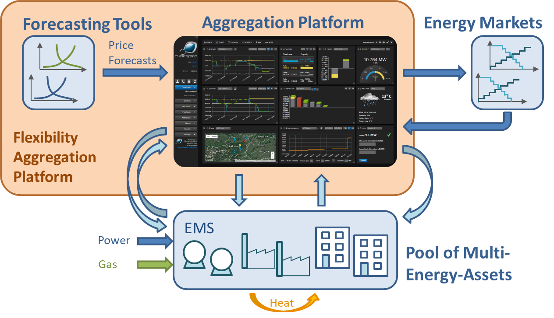
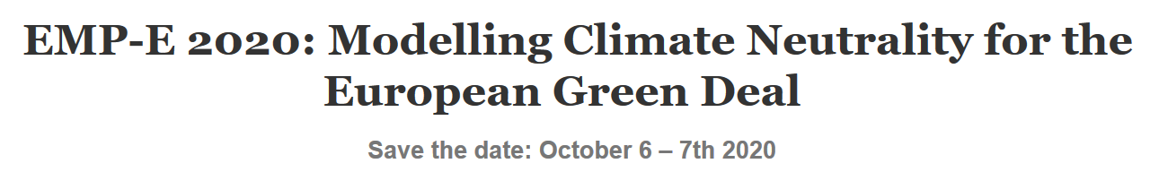
Future results
2020 - Tools
Optimization tools for MES
Aggregation platform
Multi-carrier market simulation platform
Specifications of Multi-energy data hub
and adaptation layer for interoperability
2020 - Assessment
Simulation of the real-life case studies under baseline and future scenarios
Opportunities and barriers for replication
Business model evaluation
2021 – Final evaluation and recommendations
Evaluation of integrated system: MES, aggregation and market platforms
Lessons learnt, technical/technological recommendations and policy recommendations
Final public workshop and policy workshop
Notes:
Régine

Slide 16
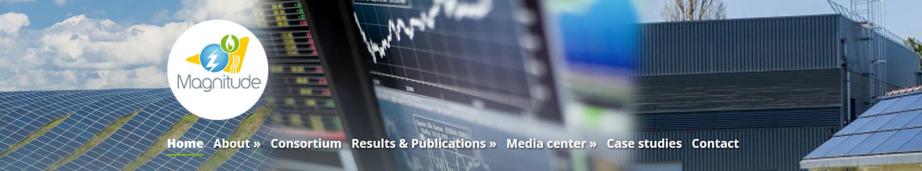

Thank you for your attention
https://www.magnitude-project.eu/
This project has received funding from the European Union’s Horizon 2020 research and innovation programme under grant agreement No 774309.
This presentation reflects only the authors’ view. The European Commission and the Innovation and Networks Executive Agency (INEA) are not responsible for any use that may be made of the information it contains

Slide 18
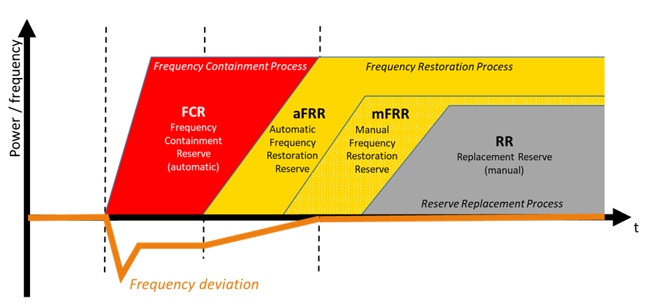
Flexibility provision to the electricity system
Balancing and frequency regulation
Two different aspects or “services”:
Procurement of reserve/capacity
Activation
Notes:
Régine

Slide 19
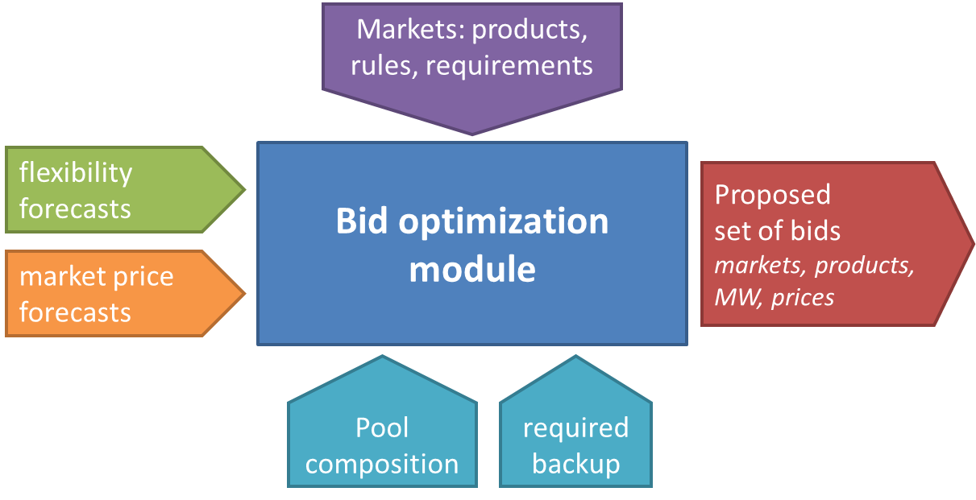
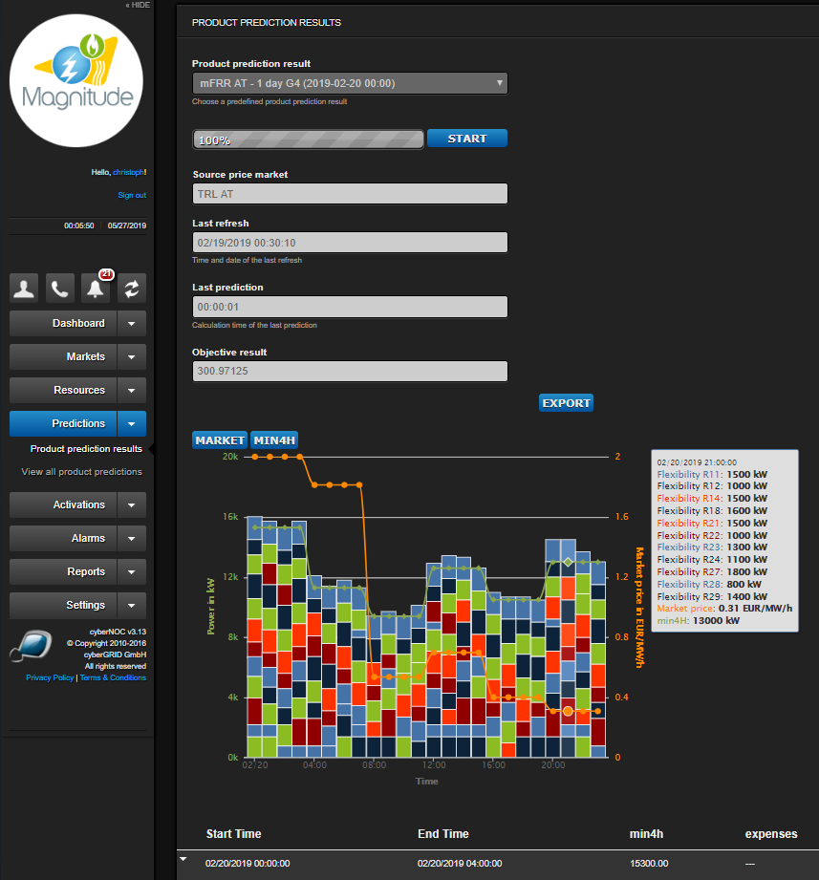
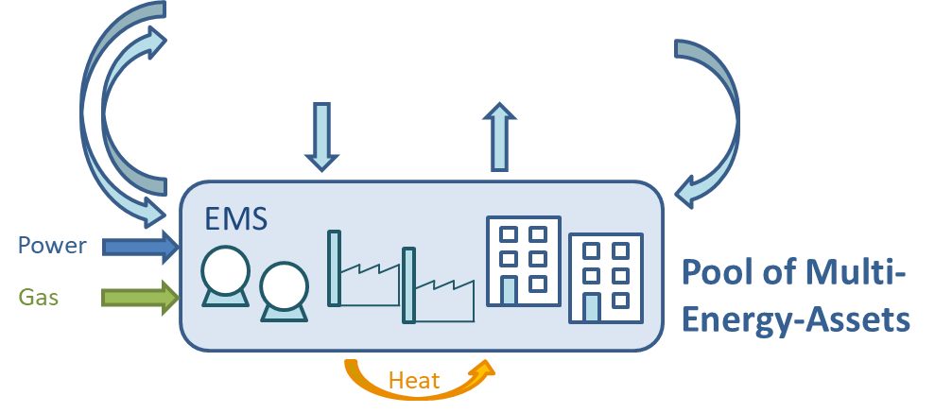
First results: aggregation platform & EMS
Aggregation platform

